Slide 1
Day 3 Character Activity
1. Students work in pairs.
2. Select three well known characters from famous movies or books, then write two sentences describing the characters of their choices.
3. Students should use as many physical and personality traits as possible to describe the characters.

Slide 2
Romeo被Juliet的 吸引了。
美丽
http://kipmcgrathtutorsscotland.files.wordpress.com/2012/03/romeo-and-juliet.jpg

Slide 3
Pn.(What is Pn.?) 被Pn.的object 吸引了。
http://www.apremiertravelagency.com/images/harry-potterOOP.jpg

Slide 4
Pn. 被Pn.的object 吸引了。
http://www.newraleigh.com/images/made/images/articles11/hunger-games-movie-wp_trio01_1020_638_70_s.jpeg

Slide 5
Pn. 被Pn.的object 吸引了。
https://encrypted-tbn0.gstatic.com/images?q=tbn:ANd9GcQcPlmSqI2HiZ2XTwAqYOwV6W_WmEawk6tc6U4mO2wE2MsDB8RZOw

Slide 6
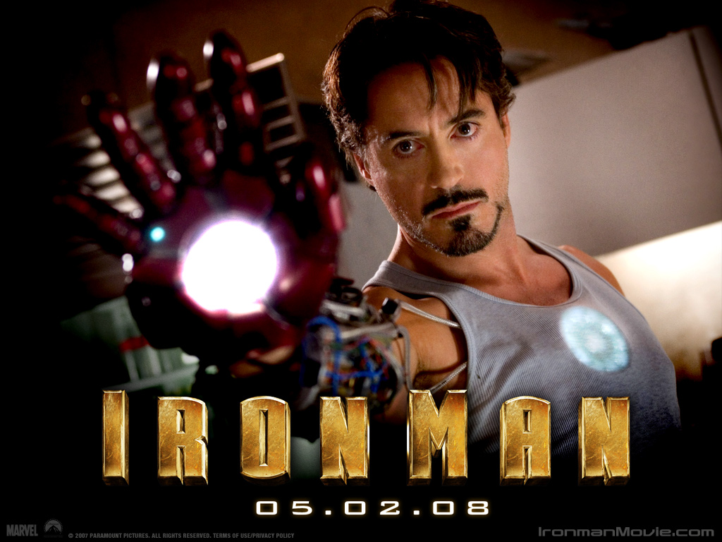
Pn. 被Pn.的object 吸引了。
http://images1.fanpop.com/images/image_uploads/Iron-Man-Robert-Downey-Jr-robert-downey-jr-942468_1024_768.jpg

Slide 7
Day 4 Homework for each pair
Create a three-slide PowerPoint file per pair
每一组做一份三页的简报
On each slide, include a picture of the character of your choice. Type the descriptive sentence in Chinese above the picture.
每张简报要有一张人物照片和两句描述人物的句子
每个人物要用三到五个本单元学的新词形容

